Slide 1

Python Course Chapter 11
Useful Modules II

Slide 2
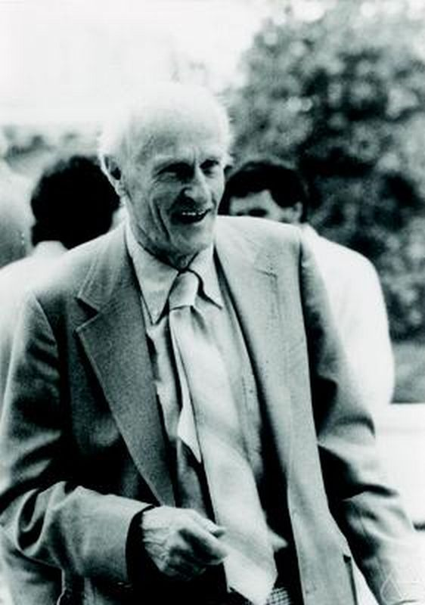
Regular Expression
A regular expression (aka regex) is a sequence of characters that specifies a search pattern in texts. The concept of regular expressions began in the 1950s, when the American mathematician Stephen Cole Kleene formalized the description of a regular language.
Regular expression allows us to search for general patterns in text data; for example, a simple email format can be user@email.com, we know we are looking for a pattern "whatever" + @ + "whatever" + ".com"

Slide 3
Regular Expression Syntax
Syntax | Description | Regular Expression | Matches
. | Dot matches any character except a newline. | r”he..o” | “hello”, “hek5o”
[] | Used to indicate a set of characters. It can be considered as a customized dot. The – in set means from ... to …. For any number between 00 to 59, we can do r”[0-5][0-9]”. For any English letter, we can do r”[a-zA-Z]” | r"he[abcl][a-d]o" | “heaao”, “hecco”
\d | Matches any character which is a decimal digit. | r”File\d\d\d” | “File100”, “File543”
\D | Matches any character which is not a decimal digit. | r”\D\D” | “He”, “we”, “?+”
\w | Matches any alphanumeric characters. | r”\w-\w” | “4-3”, “4-t”, “a-b”
\W | Matches any non alphanumeric characters, such as +, ?, or ! | r”\W” | “+”

Slide 4
Regular Expression Syntax
Syntax | Description | Regular Expression | Matches
\s | Matches the whitespaces. | r”a\sb\sc” | “a b c”
\S | Matches the non whitespaces. | r”\S\S\S\S\S” | “AKB48”
* | Kleene star. It matches 0 or more occurrence of something. It works with any alphanumeric characters, \, dot and []. | r”ab*” | “a”, “ab”, “abbbbb”
+ | It matches 1 or more occurrence of something. It works with any alphanumeric characters, \, dot and []. | r”ab+” | “ab”, “abbbbbbb”
{m} | Specifies that exactly m copies of RE. For example, r”\d{3}” is the same as r”\d\d\d”. It works with any alphanumeric characters, \, dot and []. | r”Hello\d{3}” | “Hello100”, “Hello456”
{m,n} | Specifies that from m to n copies of RE. | r” Hello\d{1,3}” | “Hello3”, “Hello58”
{m,} | Specifies m or more copies of RE. | r” Hello\d{1,}” | “Hello3”, “Hello588873”

Slide 5
Regular Expression Syntax
Syntax | Description | Regular Expression | Matches
\. | Since dot has a special meaning in RE, we use \. to find dot in a string. | r”\.*” | “”, “.”, “…….”
\b | matches the empty string at the beginning or end of a word. | r“\bhello” | “hello”
| | A | B creates a RE that matches A or B, where A, B are both RE. | r”[a-zA-Z]+|[0-9]+” | “Hello”, “56778”
Check the Python documentation for examples.
*. If you cannot figure out how to write one regular expression for a very general-purpose (such as phone number), just google it. People already have really good ones.

Slide 6
Regular Expression
For example, if we want to write a regular expression that checks if one email is valid, then we do:
regex = r'\b[A-Za-z0-9._%+-]+@[A-Za-z0-9.-]+\.[A-Za-z]{2,}\b’
This means:
The email has to start and end with some words at the front. There should be at least one character (that’s why we put + after [])
The email must have @
There should be at least one char after @, before, the dot.
After the dot, there should be 2 or more English letters.

Slide 7
Regular Expression
We can also use parathesis to match whatever regular expression is inside the parentheses. It will indicate the start and end of a group; the contents of a group can be retrieved after a match has been performed through a tuple.
The purpose of learning regex is because many data in the real world are not well-formatted. That means we have to deal with data in different forms. Regex is the best tool to work with them.

Slide 8
Zip Files and Folders
The zipfile module is the Python standard zip file module; it supports lossless data compression. By lossless compression, we mean that the compression algorithm allows the original data to be perfectly reconstructed from the compressed data.
Lossy | Lossless
A file does not restore or rebuilt in its original form after compression. | A file can be restored in its original form.
Lossy compression is also termed as irreversible compression. | Lossless Compression is also termed as reversible compression.
JPEG, MPEG | PNG, GIF, Huffman-Encoding, Python zipfile module

Slide 9

Zip Files and Folders
The module doesn’t support to zip an entire directory at a time. To do so, we need to
Use os.walk() method to go through each subfolders in the directory, and zip everything together. (Not recommended.)
use shutil module built-in method shutil.make_archive(). (Recommended)

Slide 10
Computational Theory
Regular Expression, Finite Automata, and Turing Machine

Slide 11
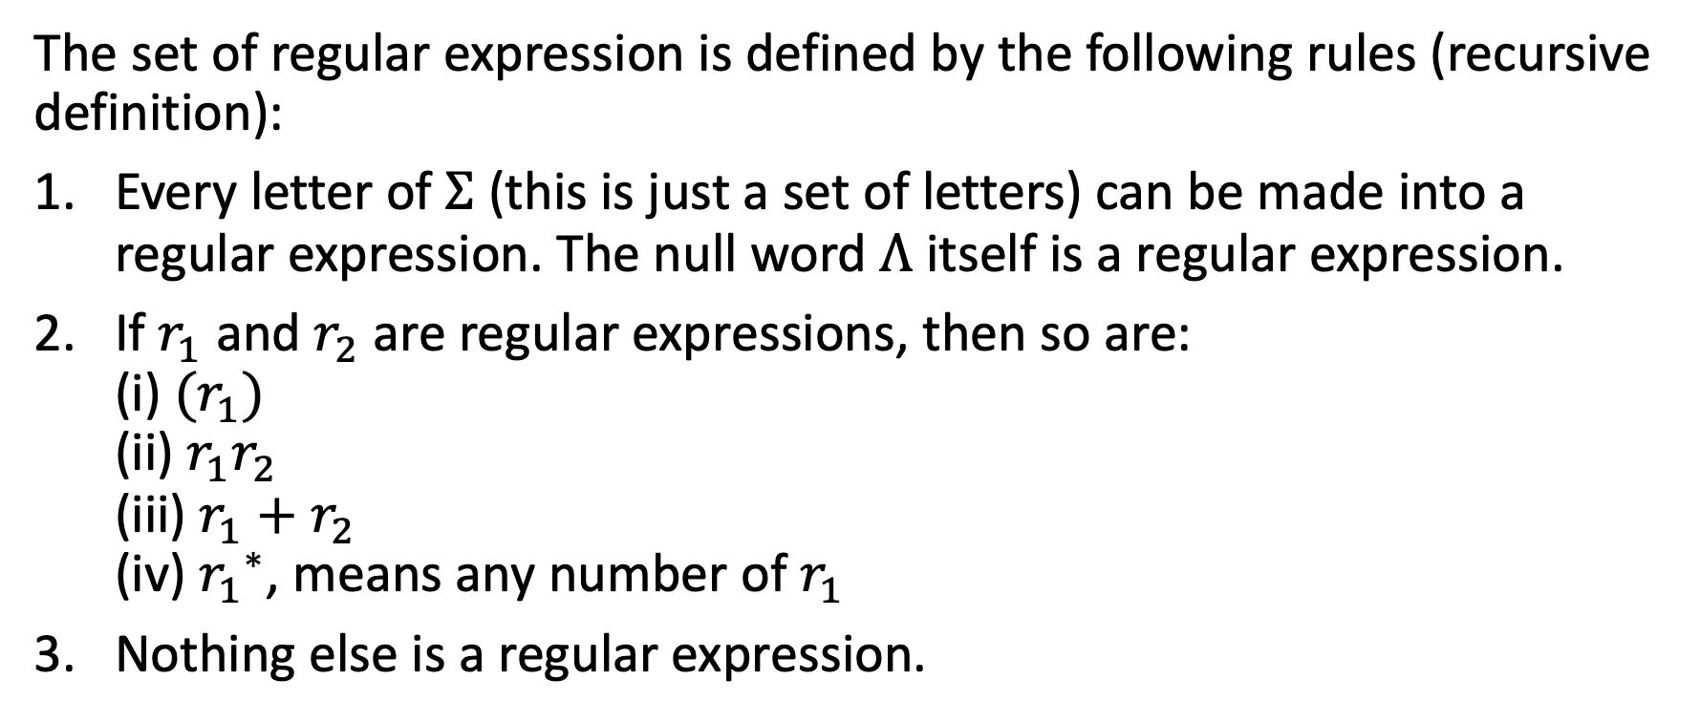
(Bonus) Regular Expression
The set of regular expression is defined by the following rules (recursive definition):
Every letter of $Σ$ (this is just a set of letters) can be made into a regular expression. The null word $Λ$ itself is a regular expression.
If $r_{1}$ and $r_{2}$ are regular expressions, then so are: (i) ${(r}_{1})$ (ii) $r_{1}r_{2}$ (iii) $r_{1}+r_{2}$ (iv) ${r_{1}}^{∗}$, means any number of $r_{1}$
Nothing else is a regular expression.

Slide 12
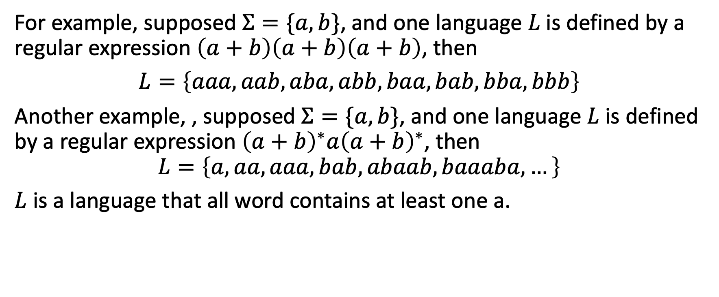
(Bonus) Regular Expression
For example, supposed $Σ=\{a, b\}$, and one language $L$ is defined by a regular expression $\left(a+b\right)\left(a+b\right)\left(a+b\right)$, then
$L=\left\{aaa, aab, aba, abb, baa, bab, bba, bbb\right\}$
Another example, , supposed $Σ=\{a, b\}$, and one language $L$ is defined by a regular expression ${\left(a+b\right)}^{∗}a{\left(a+b\right)}^{∗}$, then
$$L=\left\{a, aa, aaa, bab, abaab, baaaba, …\right\}$$
$L$ is a language that all word contains at least one a.

Slide 13
(Bonus) Finite Automata
A finite-state machine (FSM) or finite-state automata is a mathematical model of computation. It is an abstract machine that can be in exactly one of a finite number of states at any given time.
The FSM can change from one state to another in response to some inputs; the change from one state to another is called a transition. An FSM is defined by a list of its states, its initial state, and the inputs that trigger each transition.
According to Kleene’s Theorem, any regular expression can be converted to finite automata, and any finite automata can be converted into a regular expression.

Slide 14
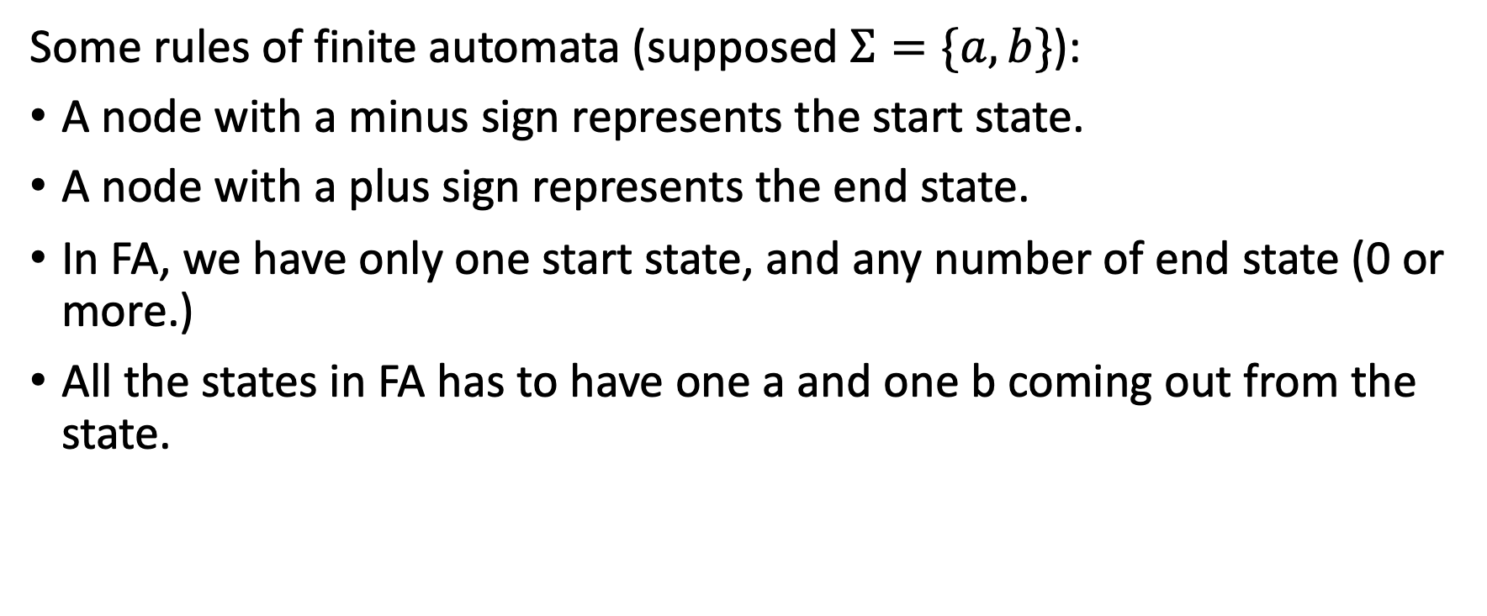
(Bonus) Finite Automata
Some rules of finite automata (supposed $Σ=\{a, b\}$):
A node with a minus sign represents the start state.
A node with a plus sign represents the end state.
In FA, we have only one start state, and any number of end state (0 or more.)
All the states in FA has to have one a and one b coming out from the state.

Slide 15
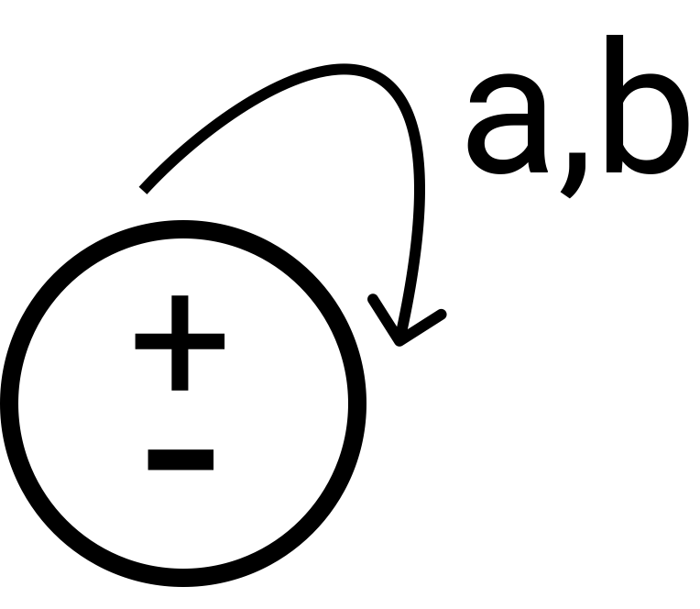
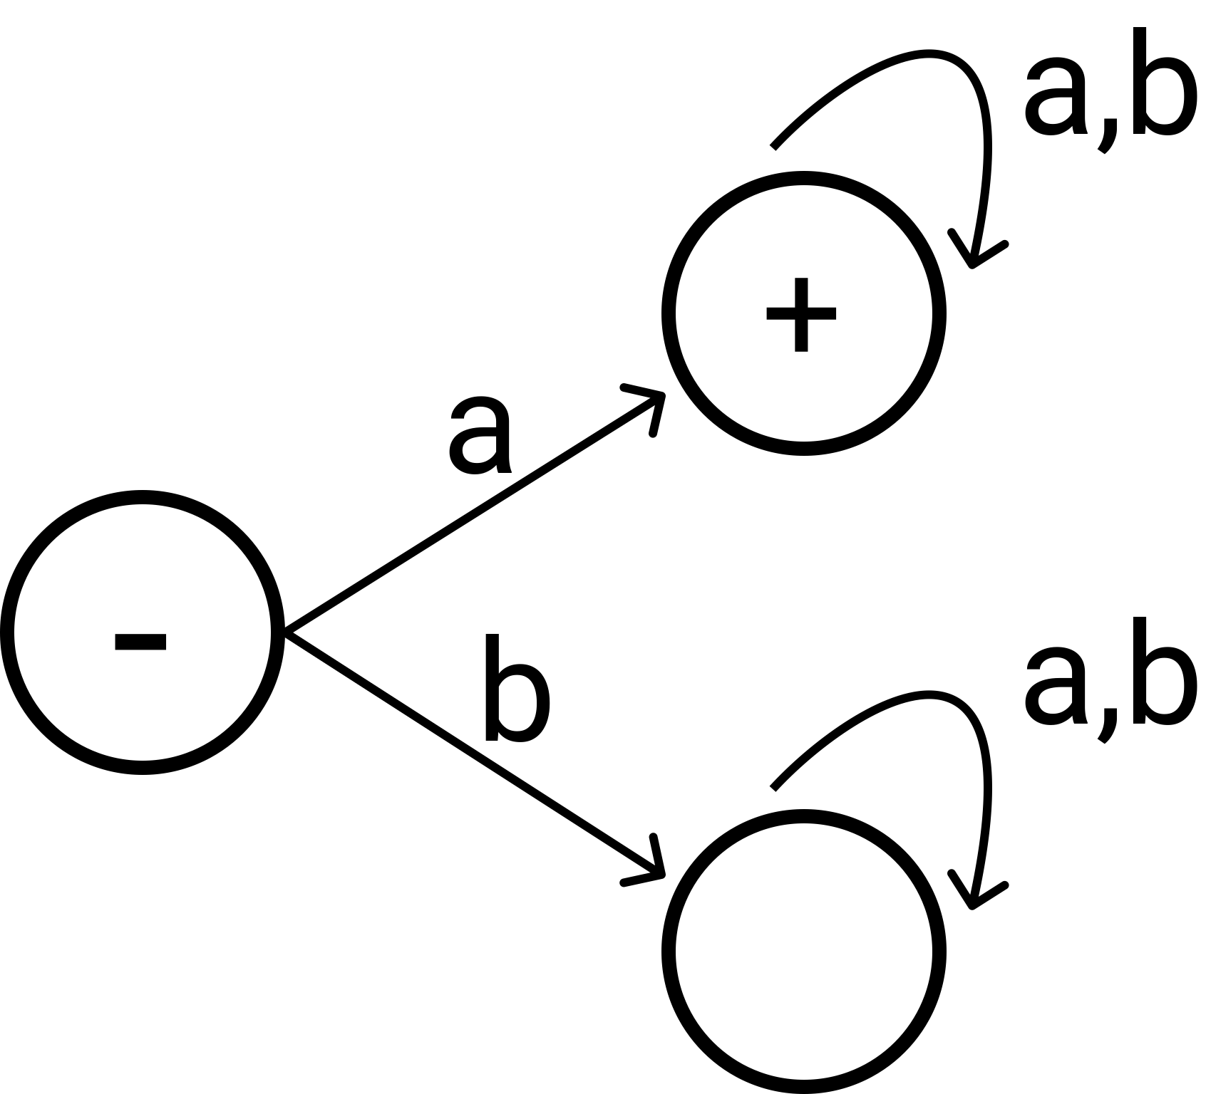
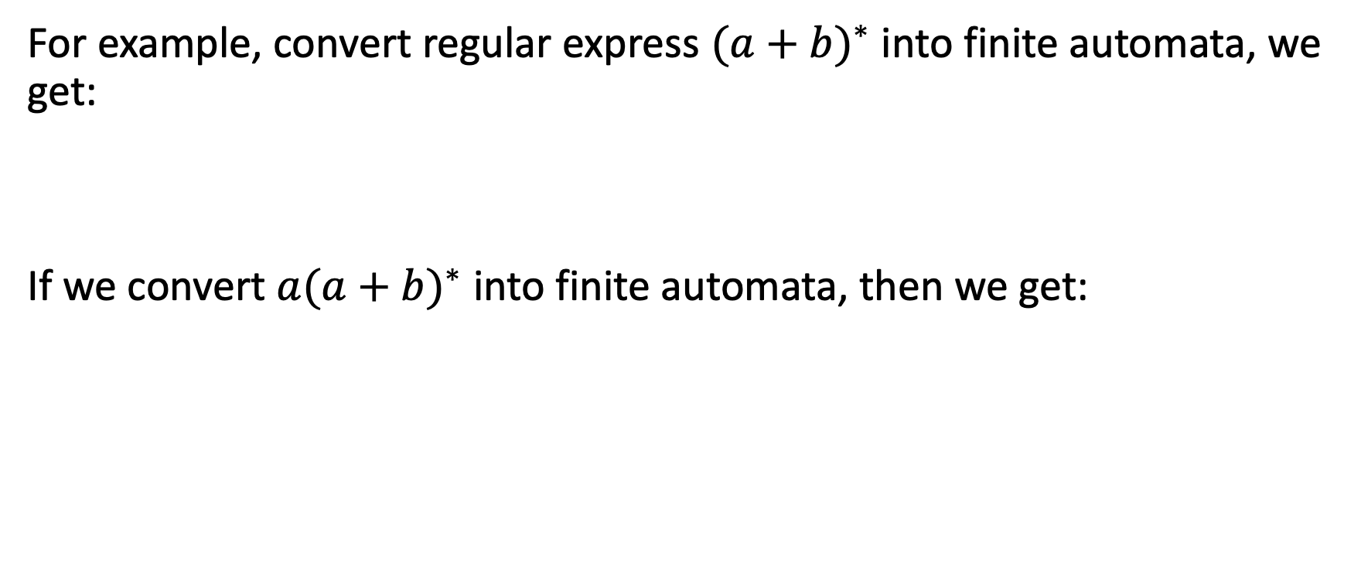
(Bonus) Finite Automata
For example, convert regular express ${(a+b)}^{∗}$ into finite automata, we get:
If we convert ${a(a+b)}^{∗}$ into finite automata, then we get:

Slide 16
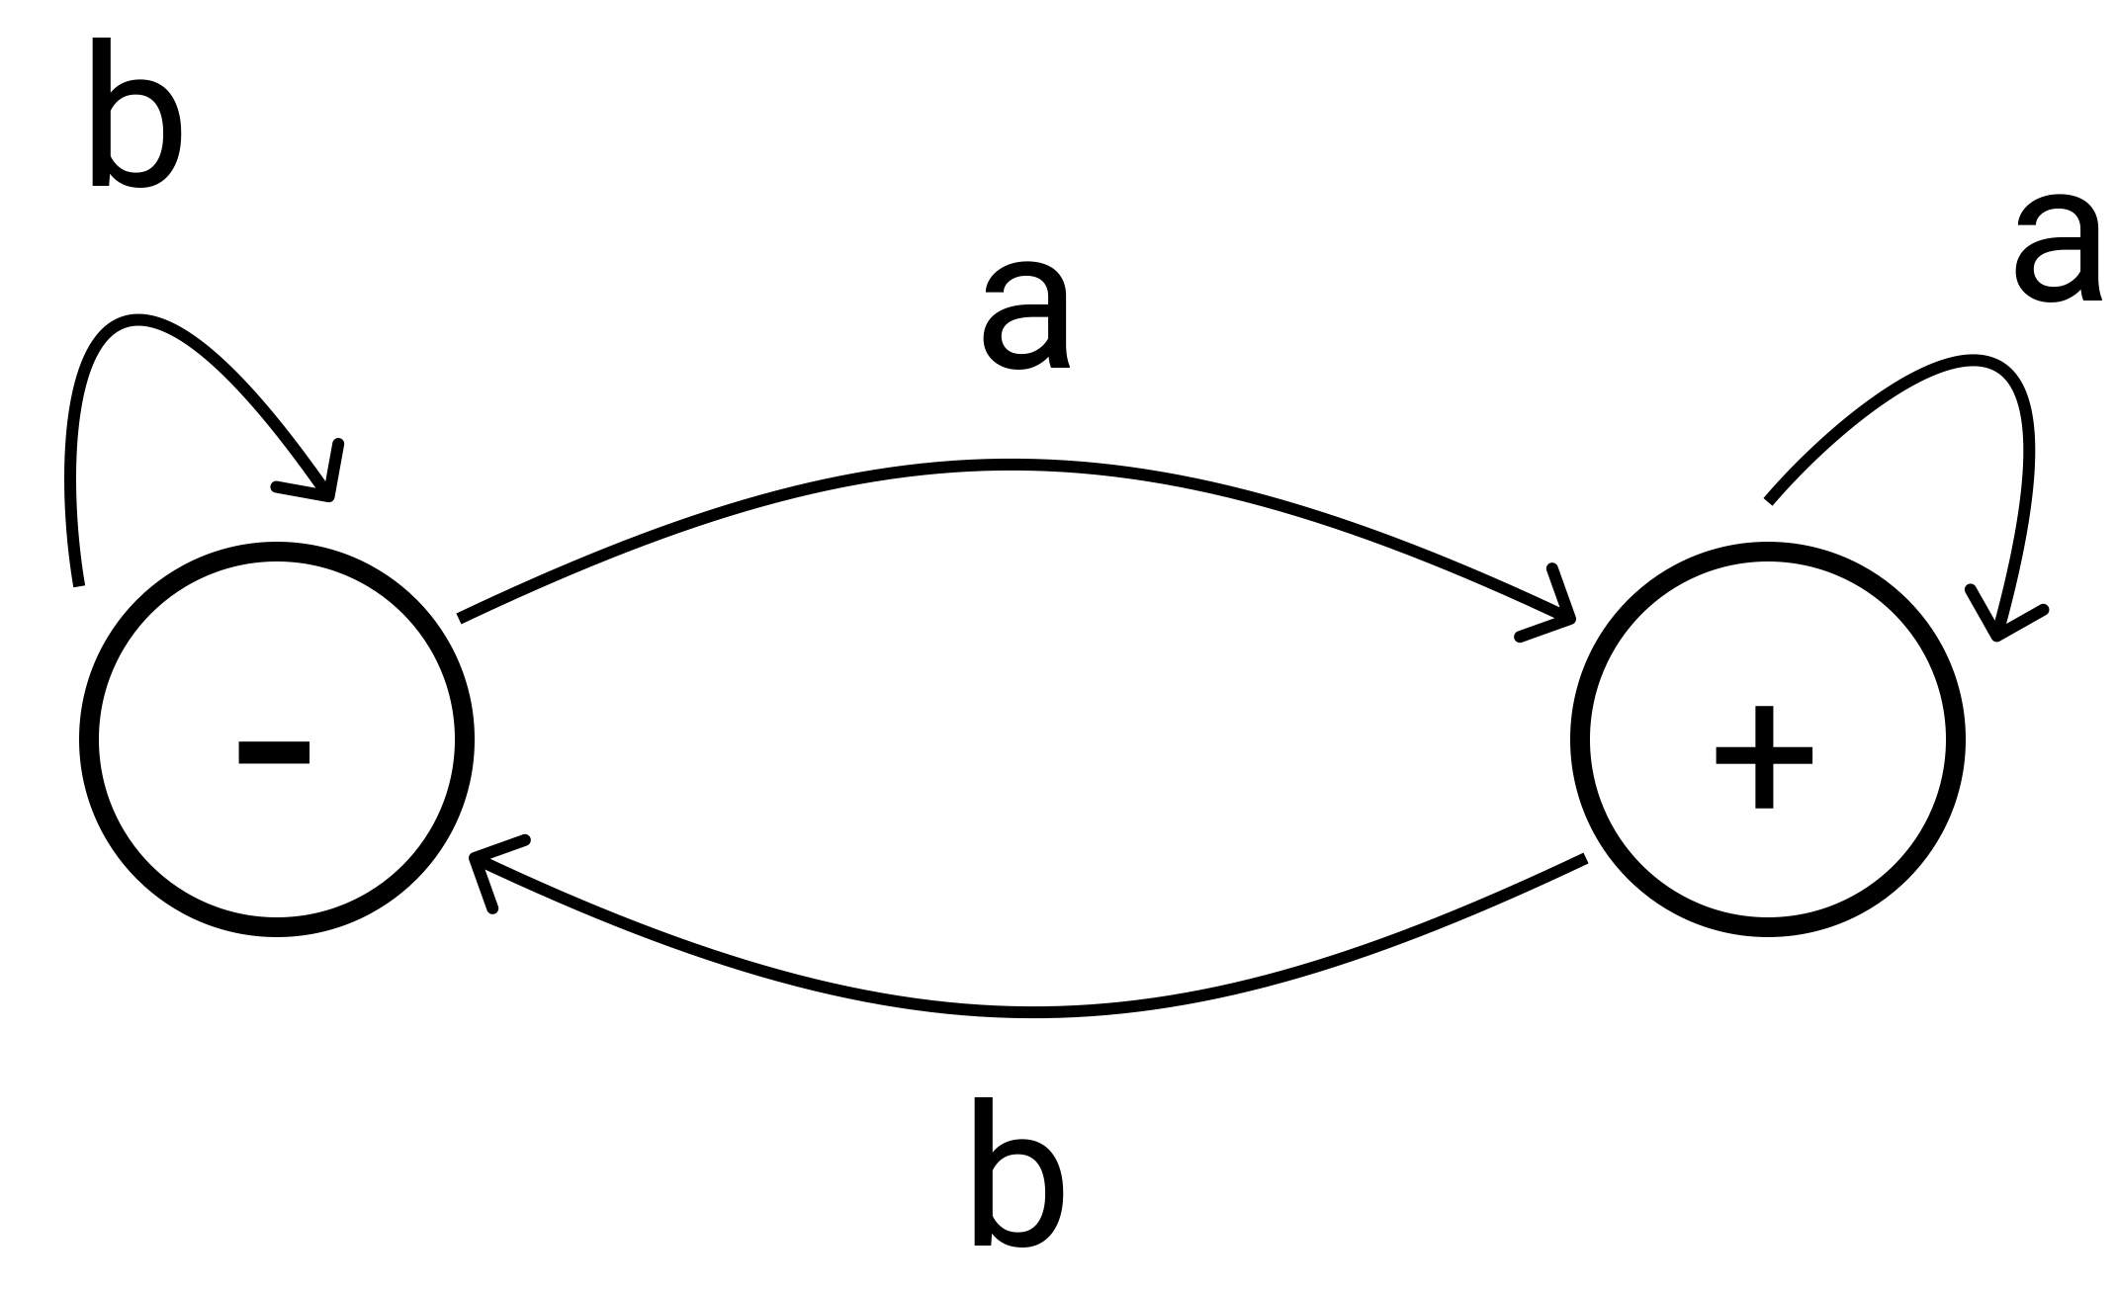

(Bonus) Finite Automata
If we convert ${(a+b)}^{∗}a$ into finite automata, then we get:
This one is tricky, but still understandable.

Slide 17
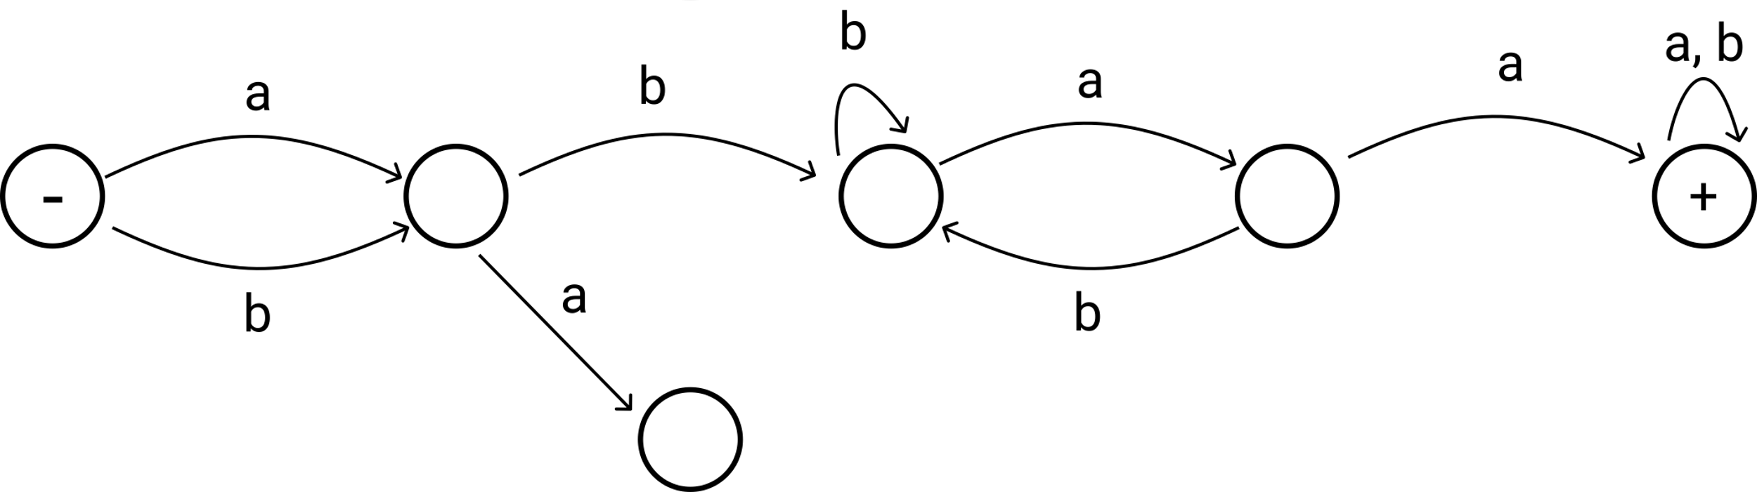

(Bonus) Finite Automata
What’s the fintite automata of ${\left(a+b\right)b(a+b)}^{∗}aa{(a+b)}^{∗}$?

Slide 18
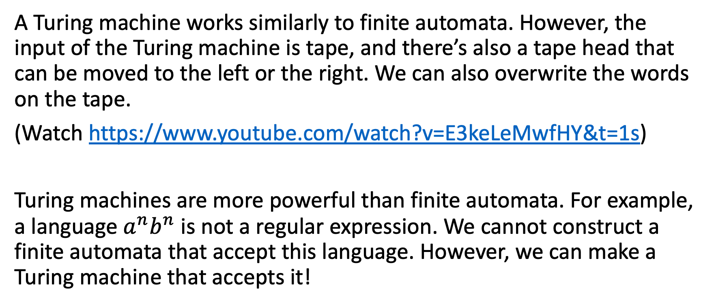
(Bonus) Turing Machine
A Turing machine works similarly to finite automata. However, the input of the Turing machine is tape, and there’s also a tape head that can be moved to the left or the right. We can also overwrite the words on the tape.
(Watch https://www.youtube.com/watch?v=E3keLeMwfHY&t=1s)
Turing machines are more powerful than finite automata. For example, a language $a^{n}b^{n}$ is not a regular expression. We cannot construct a finite automata that accept this language. However, we can make a Turing machine that accepts it!

Slide 19
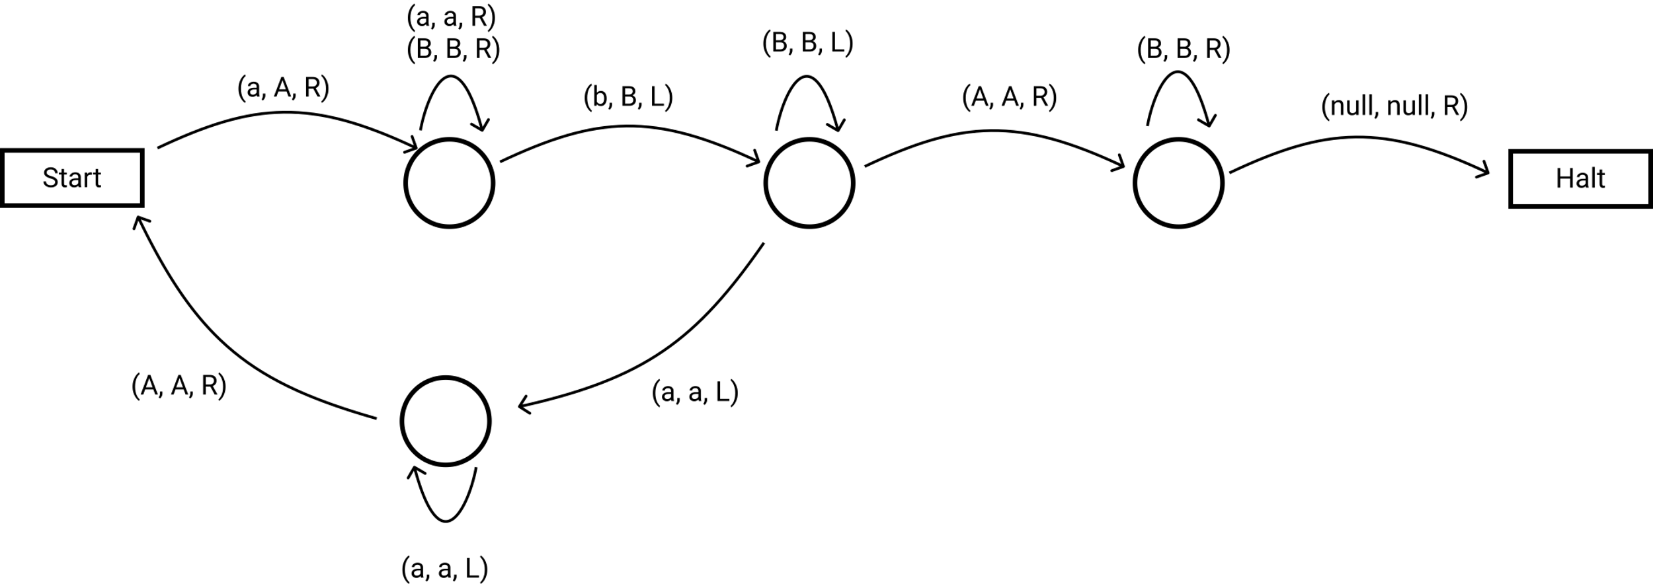
(Bonus) Turing Machine
Changes on our tape:
aaabbb
Aaabbb
AaaBbb
AAaBbb
AAaBBb
AAABBb
AAABBB
AAABBB△ => Halt

Slide 20
(Bonus) Turing Machine
An algorithm is a finite, executable sequence of steps that computes a function. Algorithms are finite both in terms of the total number of steps in the algorithm’s specification, and in terms of the number of steps executed when the algorithm runs.
All of the steps are executable, meaning that they reduce to some sort of unambiguous symbolic manipulation/transformation. An example of an executable step is: “add two integer-valued variables x and y”.
Therefore, any algorithm can be implemented by a Turing Machine.

Slide 21
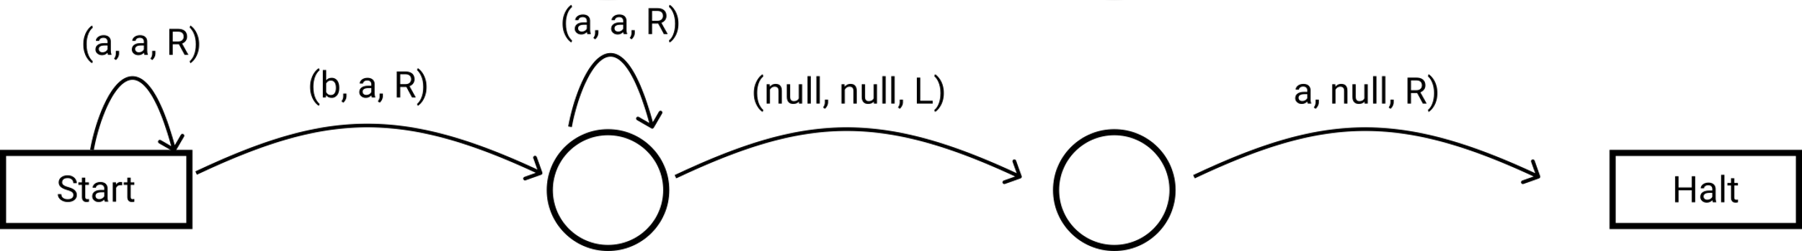
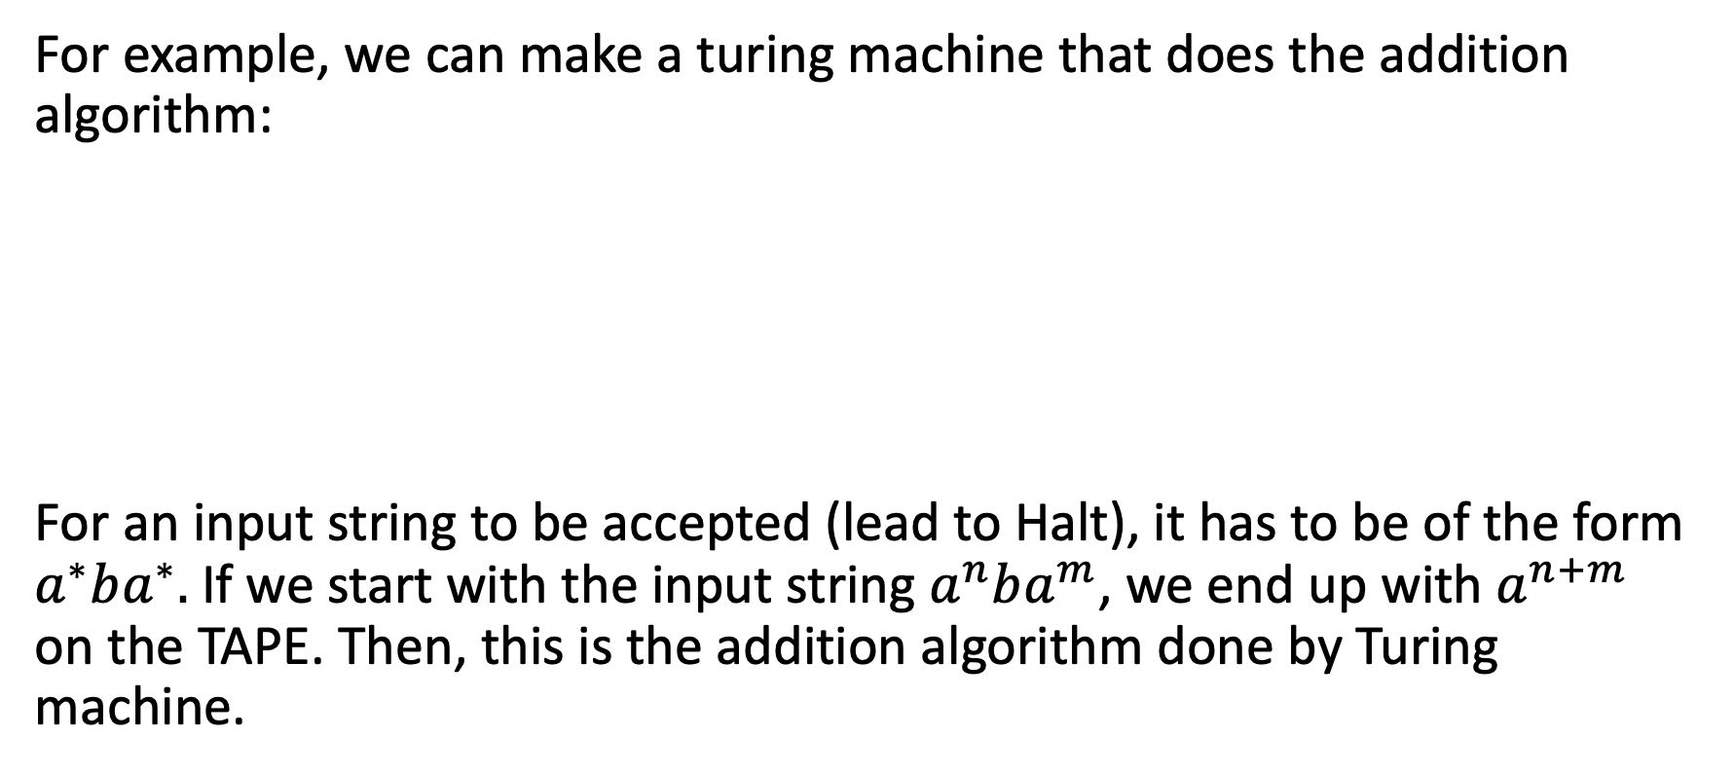
(Bonus) Turing Machine
For example, we can make a turing machine that does the addition algorithm:
For an input string to be accepted (lead to Halt), it has to be of the form $a^{∗}ba^{∗}.$If we start with the input string $a^{n}ba^{m}$, we end up with $a^{n+m}$ on the TAPE. Then, this is the addition algorithm done by Turing machine.

